Slide 1
Scheduling (Work Breakdown Structure, Activity Networks, Critical Path Method (CPM), PERT Charts, Gantt Charts), Risk Management
Organization & team structure, Software Configuration Management

Slide 2
Project Scheduling
A schedule in your project’s time table actually consists of sequenced activities and milestones that are needed to be delivered under a given period of time.
Project-task scheduling is a significant project planning activity.
It comprises deciding which functions would be taken up when.

Slide 3
To schedule the project plan, a software project manager wants to do the following:
Identify all the functions required to complete the project.
Break down large functions into small activities.
Determine the dependency among various activities.
Establish the most likely size for the time duration required to complete the activities.
Allocate resources to activities.
Plan the beginning and ending dates for different activities.
Determine the critical path. A critical way is the group of activities that decide the duration of the project.

Slide 4
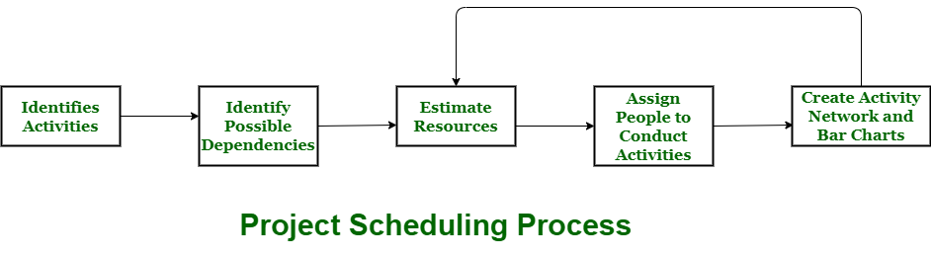
Project scheduling Process

Slide 5
Process
The manager needs to estimate time and resources of project while scheduling project.
All activities in project must be arranged in a coherent sequence that means activities should be arranged in a logical and well-organized manner for easy to understand.
Initial estimates of project can be made optimistically which means estimates can be made when all favourable things will happen and no threats or problems take place.

Slide 6
Cont..
The total work is separated or divided into various small activities or tasks during project schedule.
Then, Project manager will decide time required for each activity or task to get completed. Even some activities are conducted and performed in parallel for efficient performance.
The project manager should be aware of fact that each stage of project is not problem-free.

Slide 7
Problems arise during Project Development Stage :
People may leave or remain absent during particular stage of development.
Hardware may get failed while performing.
Software resource that is required may not be available at present, etc.

Slide 8
Resources required for Development of Project :
Human effort
Sufficient disk space on server
Specialized hardware
Software technology
Travel allowance required by project staff, etc.

Slide 9
Advantages of Project Scheduling :
There are several advantages provided by project schedule in our project management:
It simply ensures that everyone remains on same page as far as tasks get completed, dependencies, and deadlines.
It helps in identifying issues early and concerns such as lack or unavailability of resources.
It also helps to identify relationships and to monitor process.
It provides effective budget management and risk mitigation.

Slide 10
Critical Path Method
Critical Path Method (CPM) is a method used in project planning, generally for project scheduling for the on-time completion of the project.
It actually helps in the determination of the earliest time by which the whole project can be completed.

Slide 11
Cont..
There are two main concepts in this method namely critical task and critical path.
Critical task is the task/activity which can’t be delayed otherwise the completion of the whole project will be delayed. It must be completed on-time before starting the other dependent tasks.
Critical path is a sequence of critical tasks/activities and is the largest path in the project network. It gives us the minimum time which is required to complete the whole project. The activities in the critical path are known as critical activities and if these activities are delayed then the completion of the whole project is also delayed.

Slide 12
Major steps of the Critical Path Method:
Identifying the activities
Construct the project network
Perform time estimation using forward and backward pass
Identify the critical path

Slide 13
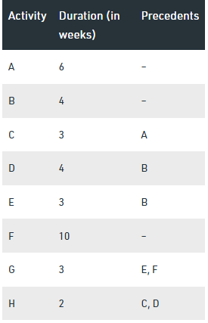
Example
The table given below contains the activity label, its respective duration (in weeks) and its precedents.
We will use critical path method to find the critical path and activities of this project.

Slide 14
Rules for designing the Activity-on-Node network diagram:
A project network should have only one start node
A project network should have only one end node
A node has a duration
Links normally have no duration
“Precedents” are the immediate preceding activities
Time moves from left to right in the project network
A network should not contain loops
A network should not contain dangles

Slide 15
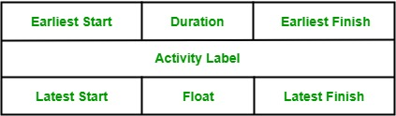
Node Representation
Float = LF - EF
LS= LF - Duration

Slide 16
Definitions
Activity label is the name of the activity represented by that node.
Earliest Start is the date or time at which the activity can be started at the earliest.
Earliest Finish is the date or time at which the activity can completed at the earliest.
Latest Start is the date or time at which the activity can be started at the latest.
Latest Finish is the date or time at which the activity can be finished at the latest.
Float is equal to the difference between earliest start and latest start or earliest finish and latest finish.

Slide 17
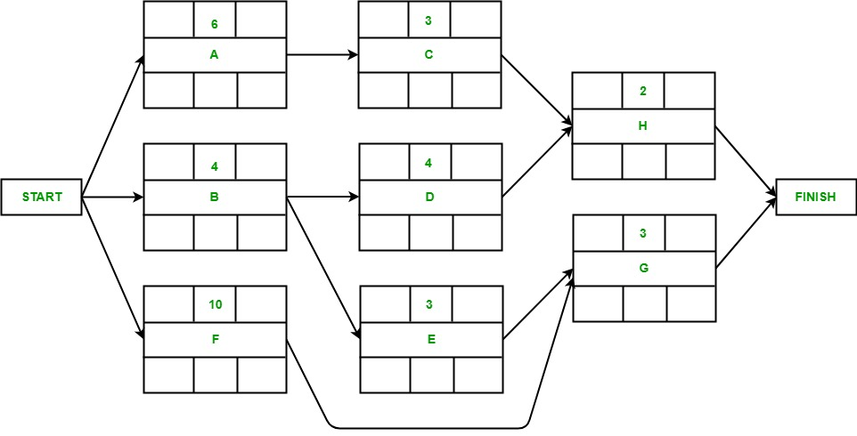
Activity-On-Node diagram:

Slide 18
Forward Pass:
The forward pass is carried out to calculate the earliest dates on which each activity may be started and completed.
Activity A may start immediately. Hence, earliest date for its start is zero i.e. ES(A) = 0. It takes 6 weeks to complete its execution. Hence, earliest it can finish is week 6 i.e. EF(A) = 6.
Activity B may start immediately. Hence, earliest date for its start is zero i.e. ES(B) = 0. It takes 4 weeks to complete its execution. Hence, earliest it can finish is week 4 i.e. EF(B) = 4.
Activity F may start immediately. Hence, earliest date for its start is zero i.e. ES(F) = 0. It takes 10 weeks to complete its execution. Hence, earliest it can finish is week 10 i.e. EF(F) = 10.

Slide 19
Cont..
Activity C starts as soon as activity A completes its execution. Hence, earliest week it can start its execution is week 6 i.e. ES(C) = 6. It takes 3 weeks to complete its execution. Hence, earliest it can finish is week 9 i.e. EF(C) = 9.
Activity D starts as soon as activity B completes its execution. Hence, earliest week it can start its execution is week 4 i.e. ES(D) = 4. It takes 4 weeks to complete its execution. Hence, earliest it can finish is week 8 i.e. EF(D) = 8.
Activity E starts as soon as activity B completes its execution. Hence, earliest week it can start its execution is week 4 i.e. ES(E) = 4. It takes 3 weeks to complete its execution. Hence, earliest it can finish is week 7 i.e. EF(E) = 7.

Slide 20
Cont..
Activity G starts as soon as activity E and activity F completes their execution. Since, activity requires the completion of both for starting its execution, we would consider the MAX(ES(E), ES(F)). Hence, earliest week it can start its execution is week 10 i.e. ES(G) = 10. It takes 3 weeks to complete its execution. Hence, earliest it can finish is week 13 i.e. EF(G) = 13.
Activity H starts as soon as activity C and activity D completes their execution. Since, activity requires the completion of both for starting its execution, we would consider the MAX(ES(C), ES(D)). Hence, earliest week it can start its execution is week 9 i.e. ES(H) = 9. It takes 2 weeks to complete its execution. Hence, earliest it can finish is week 11 i.e. EF(H) = 11.

Slide 21
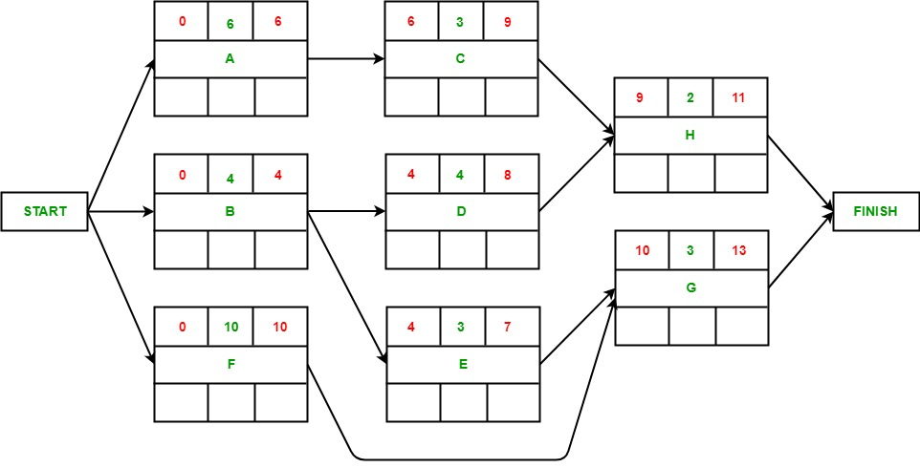
Forward Pass:

Slide 22
Backward Pass:
The backward pass is carried out to calculate the latest dates on which each activity may be started and finished without delaying the end date of the project. Assumption: Latest finish date = Earliest Finish date (of project).

Slide 23
Cont..
Activity G’s latest finish date is equal to the earliest finish date of the precedent activity of finish according to the assumption i.e. LF(G) = 13. It takes 3 weeks to complete its execution. Hence, latest it can start is week 10 i.e. LS(G) = 10.
Activity H’s latest finish date is equal to the earliest finish date of the precedent activity of finish according to the assumption i.e. LF(H) = 13. It takes 2 weeks to complete its execution. Hence, latest it can start is week 11 i.e. LS(H) = 11.
The latest end date for activity C would be the latest start date of H i.e. LF(C) = 11. It takes 3 weeks to complete its execution. Hence, latest it can start is week 8 i.e. LS(C) = 8.

Slide 24
Cont..
The latest end date for activity D would be the latest start date of H i.e. LF(D) = 11. It takes 4 weeks to complete its execution. Hence, latest it can start is week 7 i.e. LS(D) = 7.
The latest end date for activity E would be the latest start date of G i.e. LF(G) = 10. It takes 3 weeks to complete its execution. Hence, latest it can start is week 7 i.e. LS(E) = 7.
The latest end date for activity F would be the latest start date of G i.e. LF(G) = 10. It takes 10 weeks to complete its execution. Hence, latest it can start is week 0 i.e. LS(F) = 0.

Slide 25
Cont..
The latest end date for activity A would be the latest start date of C i.e. LF(A) = 8. It takes 6 weeks to complete its execution. Hence, latest it can start is week 2 i.e. LS(A) = 2.
The latest end date for activity B would be the earliest of the latest start date of D and E i.e. LF(B) = 7. It takes 4 weeks to complete its execution. Hence, latest it can start is week 3 i.e. LS(B) = 3.

Slide 26
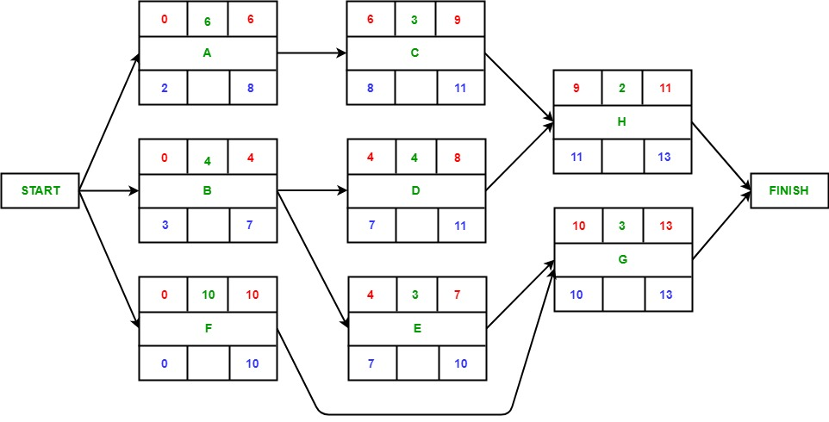
Backward Pass:

Slide 27
Identifying Critical Path:
Critical path is the path which gives us or helps us to estimate the earliest time in which the whole project can be completed.
Any delay to an activity on this critical path will lead to a delay in the completion of the whole project.
In order to identify the critical path, we need to calculate the activity float for each activity.

Slide 28
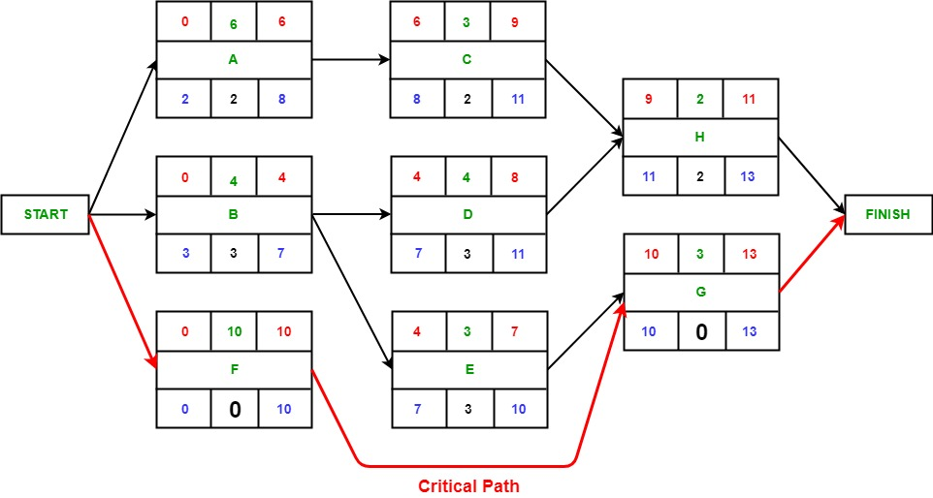
Critical Path:

Slide 29
Question to solve
Activity | Predecessor | Duration
A | -- | 5
B | A | 4
C | A | 5
D | B | 6
E | C | 3
F | D,E | 4
Which one is the Critical Path?
A-C-E-F
A-B-D-F
A-B-E-F
A-C-D-F

Slide 30
Project Evaluation and Review Technique (PERT)
PERT is appropriate technique which is used for the projects where the time required or needed to complete different activities are not known.
PERT is majorly applied for scheduling, organization and integration of different tasks within a project.
It provides the blueprint of project and is efficient technique for project evaluation .

Slide 31
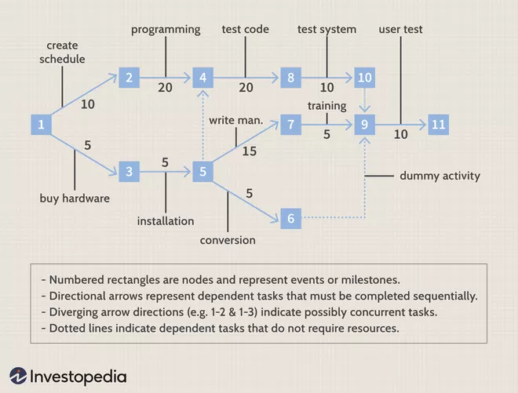
A well-constructed PERT chart looks like this:

Slide 32
Characteristics of PERT:
It serves as a base for obtaining the important facts for implementing the decision-making.
It forms the basis for all the planning activities.
PERT helps management in deciding the best possible resource utilization method.
PERT take advantage by using time network analysis technique.
PERT presents the structure for reporting information.
It helps the management in identifying the essential elements for the completion of the project within time.

Slide 33
3 types of times
Optimistic time – It is the shortest possible time in which the activity can be finished. It assumes that every thing goes very well. This is denoted by t₀.
Most likely time – It is the estimate of the normal time the activity would take. This assumes normal delays. If a graph is plotted in the time of completion and the frequency of completion in that time period, then most likely time will represent the highest frequency of occurrence. This is denoted by t_{m}.
Pessimistic time – It represents the longest time the activity could take if everything goes wrong. As in optimistic estimate, this value may be such that only one in hundred or one in twenty will take time longer than this value. This is denoted by tp.

Slide 34
In PERT calculation, all values are used to obtain the percent expected value. PERT is probabilistic method.
Expected time – It is the average time an activity will take if it were to be repeated on large number of times and is based on the assumption that the activity time follows Beta distribution, this is given by
t_{e} = ( t₀ + 4 t_{m} + t_{p} ) / 6
The variance for the activity is given by
σ² = [(t_{p} – t_{o}) / 6] ²

Slide 35
Example 1
ACTIVITY | OPTIMISTIC | MOST LIEKLY | PESSIMISTIC
1-2 | 1 | 7 | 13
1-6 | 2 | 5 | 14
2-3 | 2 | 14 | 26
2-4 | 2 | 5 | 8
3-5 | 7 | 10 | 9
4-5 | 5 | 5 | 7
6-7 | 5 | 8 | 29
5-8 | 3 | 3 | 9
7-8 | 8 | 17 | 32

Slide 36
Questions
Draw the project network
Find the expected duration and variance of each activity
Calculate earliest and latest occurrence of each event.
Calculate expected project length
Calculate standard deviation and variance of project length
Find the probability of project completing in the 40 days

Slide 37
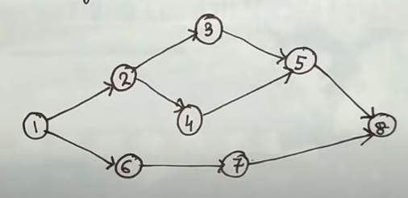
Draw the project network

Slide 38
Find the expected duration and variance of each activity
t_{e} = ( t₀ + 4 t_{m} + t_{p} ) / 6
σ² = [(t_{p} – t_{o}) / 6] ²
ACTIVITY | OPTIMISTIC | MOST LIEKLY | PESSIMISTIC | t_{e} | σ²
1-2 | 1 | 7 | 13 | 7 | 4
1-6 | 2 | 5 | 14 | 6 | 4
2-3 | 2 | 14 | 26 | 14 | 16
2-4 | 2 | 5 | 8 | 5 | 1
3-5 | 7 | 10 | 9 | 11 | 4
4-5 | 5 | 5 | 7 | 7 | 4
6-7 | 5 | 8 | 29 | 11 | 16
5-8 | 3 | 3 | 9 | 4 | 1
7-8 | 8 | 17 | 32 | 18 | 16

Slide 39
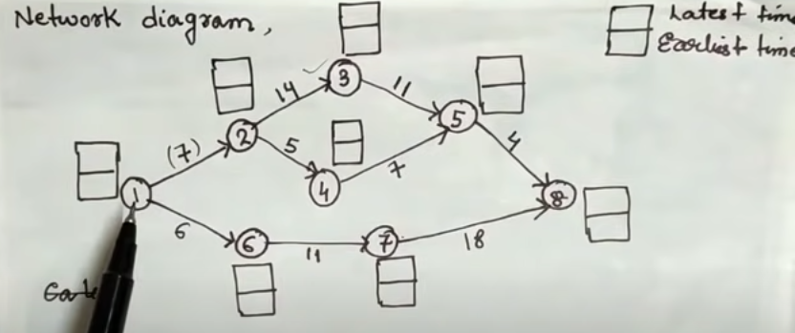
Calculate earliest and latest occurrence of each event.

Slide 40
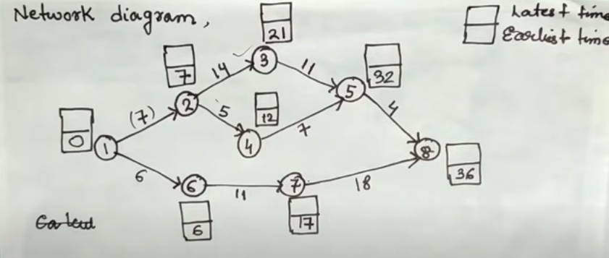
Earliest Time

Slide 41
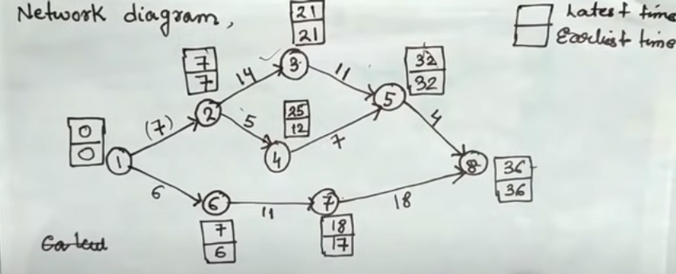
Latest Time

Slide 42
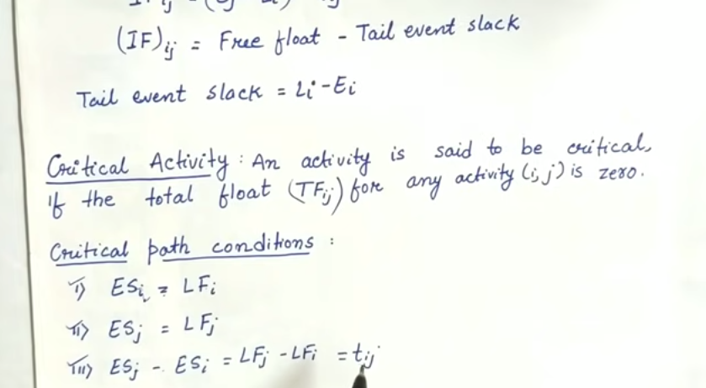
Critical Activity

Slide 43
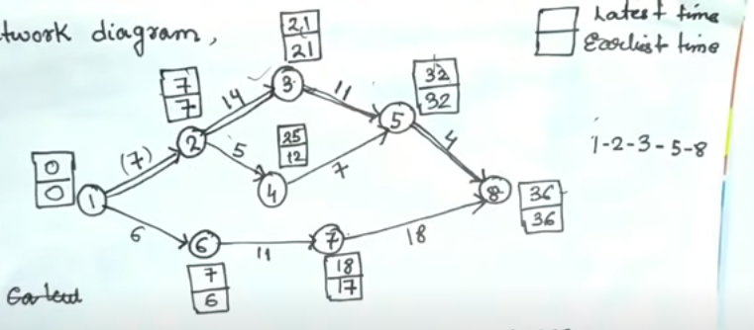
Critical Path

Slide 44
Calculate expected project length
t_{e} = ( t₀ + 4 t_{m} + t_{p} ) / 6
σ² = [(t_{p} – t_{o}) / 6] ²
ACTIVITY | OPTIMISTIC | MOST LIEKLY | PESSIMISTIC | t_{e} | σ²
1-2 | 1 | 7 | 13 | 7 | 4
1-6 | 2 | 5 | 14 | 6 | 4
2-3 | 2 | 14 | 26 | 14 | 16
2-4 | 2 | 5 | 8 | 5 | 1
3-5 | 7 | 10 | 9 | 11 | 4
4-5 | 5 | 5 | 7 | 7 | 4
6-7 | 5 | 8 | 29 | 11 | 16
5-8 | 3 | 3 | 9 | 4 | 1
7-8 | 8 | 17 | 32 | 18 | 16
Expected duration = 7+14+11+4= 36 weeks

Slide 45
Calculate standard deviation and variance of project length
t_{e} = ( t₀ + 4 t_{m} + t_{p} ) / 6
σ² = [(t_{p} – t_{o}) / 6] ²
ACTIVITY | OPTIMISTIC | MOST LIEKLY | PESSIMISTIC | t_{e} | σ²
1-2 | 1 | 7 | 13 | 7 | 4
1-6 | 2 | 5 | 14 | 6 | 4
2-3 | 2 | 14 | 26 | 14 | 16
2-4 | 2 | 5 | 8 | 5 | 1
3-5 | 7 | 10 | 9 | 11 | 4
4-5 | 5 | 5 | 7 | 7 | 4
6-7 | 5 | 8 | 29 | 11 | 16
5-8 | 3 | 3 | 9 | 4 | 1
7-8 | 8 | 17 | 32 | 18 | 16
Variance = σ² = 4+16+4+1 = 25
Standard deviation = σ = 5

Slide 46
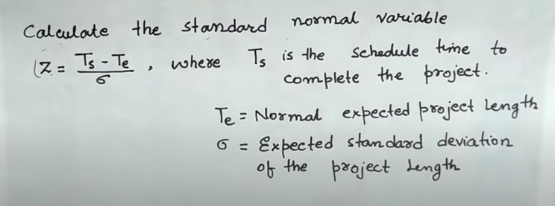
Find the probability of project completing in the 40 days

Slide 47

Cont..
D = $\frac{T_{s}−T_{e}}{\text{σ}}$ = $\frac{40−36}{5}$ = 0.8
Probability = P (Z ≤ D) = P (Z ≤ 0.8) = 0.7881 = 78.1%

Slide 48
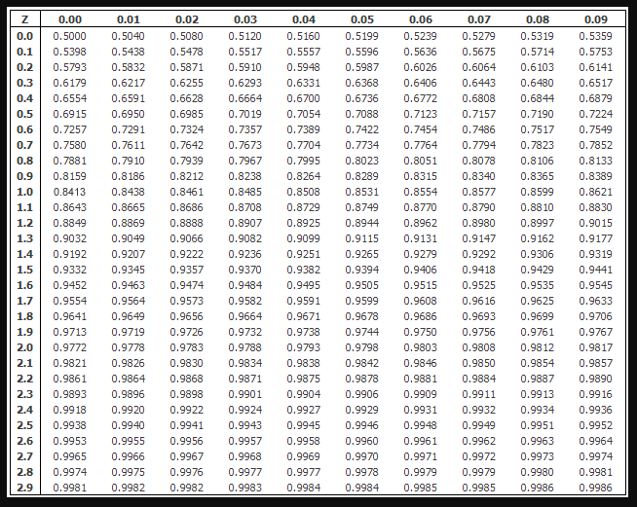
Standard Normal Distribution
Table

